Slide 1

Data Preprocessing for Machine Learning By – Vishal Kumar Data Scientist (Vehicle Diagnostics) Tata Consultancy Services

Slide 2
Agenda
What are we dealing with?
Source of Data
Description of Data
Preparation of Data
Preprocessing using Visualization
Machine Learning
Visualization of Data
Practical Implementation on Titanic Dataset

Slide 3
What are we dealing with?
Really, you've got to identify your problem.
Do you know what you want to end up with?
So the thing here is that you must have knowledge about the problem.

Slide 4

Source of Data

Slide 5
Source of Data
DATA
Do you even have it?
Yes? Great!
No? You’re in trouble!

Slide 6
Source of Data
Good Sources to get Data for Practicing–
UCI Machine Learning Repository
Kaggle Datasets
Get your own data using Web Scraping

Slide 7
Preparation of Data
Now that you’ve got your data, prepare it!
Wait! What does that mean?

Slide 8
Preparation of Data
Let’s see what can your data have!
Holes
Improper Format
Absurd Scale

Slide 9
Preparation of Data
Different Methods.
Ignoring a part - Risk
Dimensionality Reduction
Standardization
Mean Normalization
Min-Max Scaling
How to fill in the holes?
- Interpolate
- Label Encoders and One Hot Encoders
- Filling the missing value with some values, to get away with missing out on certain features

Slide 10
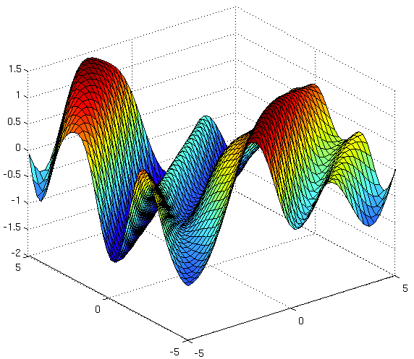
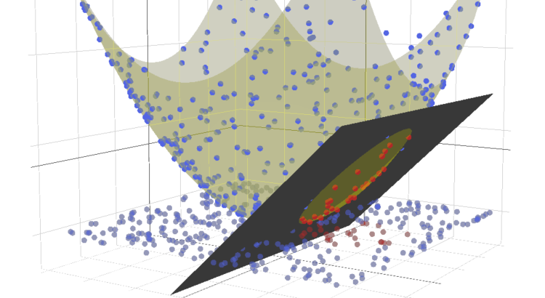
Preprocess using Visualization
You can also simply visualize the data to find out what variables in your data is necessary and what is not.

Slide 11
Preprocess using Visualization
Now that you've got your data in your hands and you've really prepared the data to be tested upon, what do you want to do.
You already know the problem, so just start working on how you’re going to solve it.

Slide 13
Machine Learning
See the different techniques and models.
Implement it.

Slide 14
Work over? Not yet.

Slide 15
Machine Learning
You've got a chance now. Improve your models.
Tune in the parameters. Very Important.
Various Examples lying all around.

Slide 16
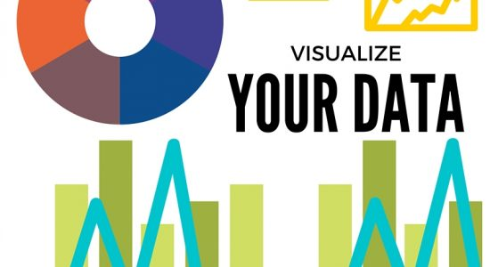

Slide 17
Visualize your Data
This. My friend, is an art!
You need to convey your discoveries to others in a way that they can relate to.
They understand - not only your findings but how and why are your findings useful.
Give your maximum effort, even more than many of the earlier stages.

Slide 18
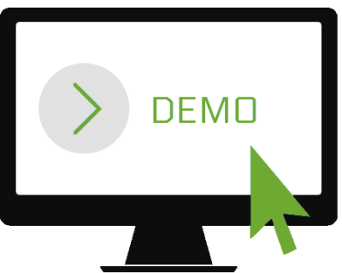

Slide 19


Connect with me on
- https://www.linkedin.com/in/vishal5164/

Slide 20


